Slide 1

Ch.22. Using Session Control in PHP
Siva R Jasthi
ICS325 – Internet Application Development
Information and Computer Sciences
Metropolitan State University

Slide 2
Outline
Session Control – Why do we need it?
Cookies
Sessions
Dual Mode of Cookies / Sessions

Slide 3
What is a cookie?
An HTTP cookie (also called web cookie, Internet cookie, browser cookie or simply cookie) is a small piece of data sent from a website and stored in a user's web browser while the user is browsing that website.
Every time the user loads the website, the browser sends the cookie back to the server to notify the website of the user's previous activity.
Cookies were designed to be a reliable mechanism for websites to remember stateful information.

Slide 4
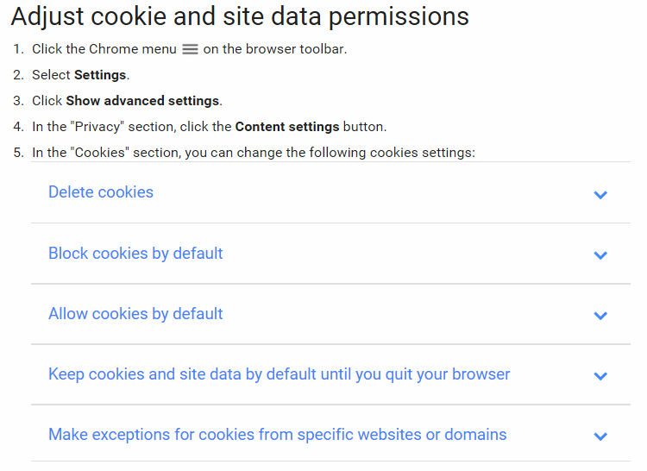
Inspecting Cookies on Chrome Browser

Slide 5
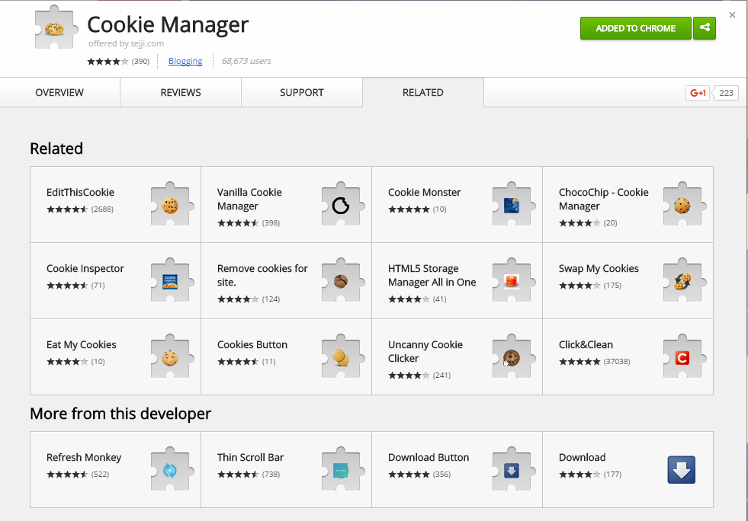
Or you can use a Chrome Extension called
Cookie Manager

Slide 6
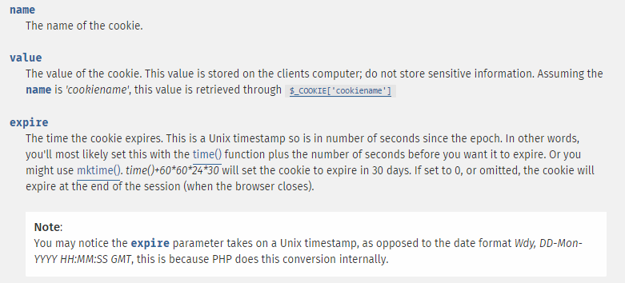
Cookies - Parameters
http://php.net/manual/en/function.setcookie.php

Slide 7
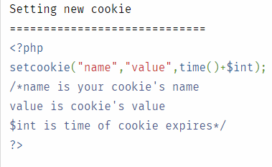
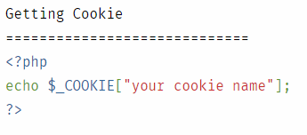
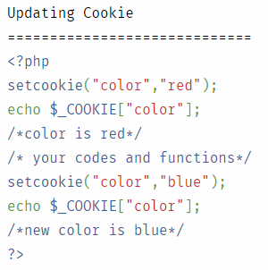
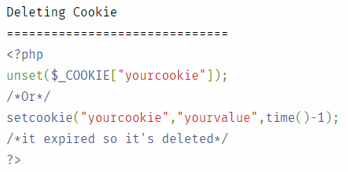
Cookies (Set, Get, Update, Delete)

Slide 8
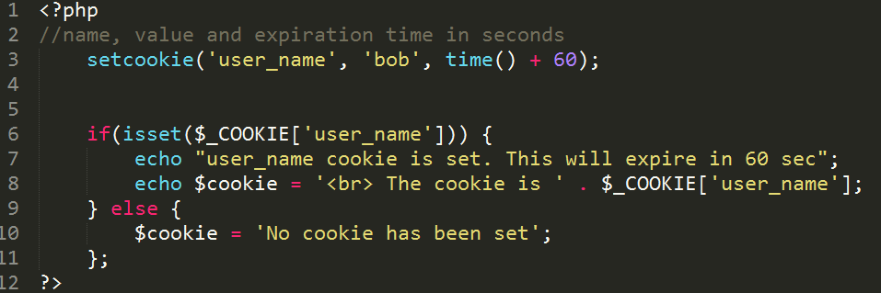
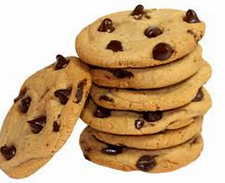
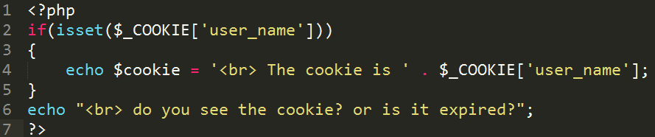
Let us try Cookies

Slide 9
When to use Cookies..? Some examples!
You booked a flight ticket from MSP to SFO at a travel web site. When you visit the same site later on, FROM and TO fields are pre-populated with MSP and SFO
You started an order and added some items to the cart. But didn’t complete the order. When you visit the same site next time, the items are shown in the shopping cart.
Your language choice, screen size, screen resolution, browser – based on these values, web pages are personalized.
Web site welcomes you upon your first access. “Welcome, Guest!” or “Welcome, Bob!”.
When you visit any web store, it makes the suggestions to you on what to buy / purchase based on your browsing history or what you looked/searched for in your previous session.

Slide 10
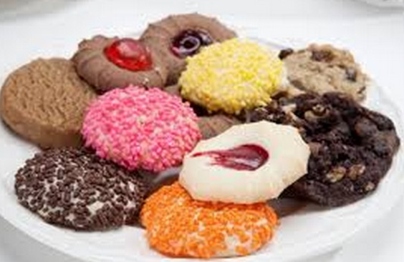
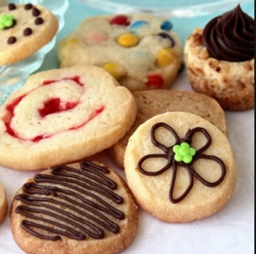
Types of Cookies
https://en.wikipedia.org/wiki/HTTP_cookie#Terminology
1. Session cookie (No expiration date; Closing the Brower expires it)
2. Persistent cookie (Expiration date is set; May also be called “Tracking Cookie”)
3. Secure cookie (can be sent only through HTTPS)
4. HttpOnly cookie (can not be set by JavaScript or other mechanisms, Only through HTTP)
5. Third-party cookie (for tracking ad history; as opposed to first-party cookie)
6 Supercookie (Top level domains *.com; Browsers typically disable these due to security concerns)
7 Zombie cookie (are created automatically through client side scripts when these are deleted)

Slide 11
Cookies - Restrictions
Cookies – Domains (1:1): Web servers can only access cookies which are set to their own domain. This domain is set by the browser when a new cookie is requested by the web server, and can only be the domain or a subdomain of the web server (the web server can choose a subdomain if it wants to). This means that cookies which were set by, for example, google.com can't be read by mozilla.com, and vice versa.
Cookie Size: According to the HTTP protocol, cookies can't be larger than 4096 Bytes (4KB) each.
Number of Cookies per domain: There is a limit to the number of cookies per domain. The number differs per browser, however, the generally used limit is twenty cookies. This is to prevent a single domain from hogging the disk space of the client.
Number of Cookies Per Browser: There is a limit to the total number of cookies on the client's harddrive. This number also differs per browser, but is usually limited to around three hundred cookies. When this number is exceeded, an older cookie is deleted before a new one is created.

Slide 12
Cookies – Restrictions (Set by the user)
User may disable the cookies (web servers can’t set the cookies any more)
User may delete a cookie manually
User may delete all cookies manually
Never assume the presence of a cookie.
If cookie is present, your web application provides personalization of User Interface or some other features.
However, the web application should also function in the absence of a cookie.

Slide 13
Cookies – they do EXPIRE
Expiration Date: Cookies have an expiration date.
This date is set so the browser can delete old cookies when they are no longer needed by the webserver.
Empty Expiration Date:
If the expiration date is empty, the cookie will be deleted when the connection with the server is closed.
This occurs when the site's window or tab is closed by the user, or when the user closes the entire browser.
These cookies, sometimes called session cookies, are mostly used for storing temporary settings.

Slide 14
What do browsers do with expired cookies?
If a cookie has expired, the browser does not send that particular cookie to the server with the page request; instead, the expired cookie is deleted.
This depends upon the specific browser and also the user's personal settings. Welcome to the world of web development, where everybody is a special case. This is one of the reasons you need to test your site extensively, with multiple browsers, from different locations.

Slide 15
Cookies –
Don’t store user names and passwords
It is tempting to store user name and password in a cookie.
And send it to server in plain text as a cheaper and quicker way of authenticating the user and providing personalization of the web pages.
Don’t!
Cookies are usually sent through a non-secure connection, so the content could easily be seen by any potential attackers.
Many spyware / rogueware specialize in going after the cookies on the client machine

Slide 16
Cookies – Best Practices
Never insert sensitive data into a cookie. A client could be browsing on a public computer, so don't leave any personal information behind.
Never trust data coming from cookies. Always filter strings and numbers! An attacker could write malicious data to the cookie in order to do something you don't want your service to do.
Try to estimate how long the cookie should be valid, and set the expiration date accordingly. You don't want to hog the client's computer with old cookies which are set to expire in a hundred years.
Always set the secure and httponly to meet your application demands. If your application doesn't edit the cookies with JavaScript, enable httponly.
If you always have an HTTPS connection, enable secure. This improves the data's integrity and confidentiality.

Slide 17
Session vs Cookies
 | Session | Cookies
Definition | A session is a collection of data stored on the server and associated with a given user (usually via a cookie containing an id code) | A cookie is a bit of data stored by the browser and sent to the server with every request.
Storage Location | Stored on server | Stored on Client
Storage Format | Files (default) or DB | Text Files
Life | Disappears when the user closes the browser | Depends on the expiration time set on the cookie
Security | More Secure | Less Secure
Reliability | Controlled and Reliable | Less reliable as users can delete or disable the cookies.
Size | No limits on size | Limited in size
Destroying | unset() or session_destroy() can explicitly kill a session | time() – 100 (setting the expiration time to past) can kill a cookie
Note: Cookies compliment sessions; Sessions store secure information. Cookies store the key to retrieve the corresponding session data.

Slide 18
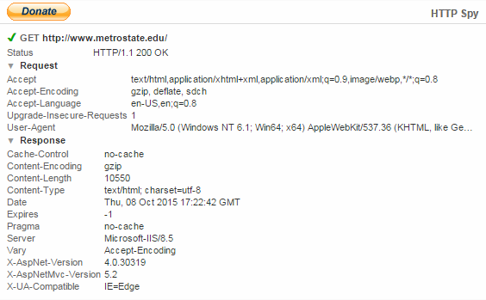
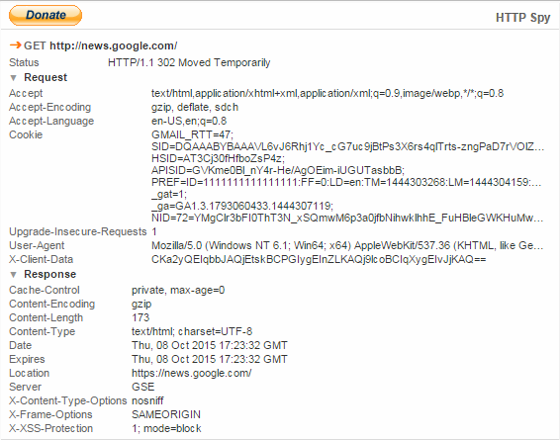
HTTP Spy – Chrome Extension
There are many tools available to observe the traffic (request and response headers) between your browser and a web server
HTTP Spy is one such extension for Chrome Browser.

Slide 19
Dual Cookie/Session method used by PHP
When you are using PHP sessions, it is not required to manually set cookies.
The session functions take care of this task for you.
You can use the function session_get_cookie_params( ) to see the contents of the cookie set by the session control.
This method returns an array containing the elements lifetime, path, domain and secure.
Session_set_cookie_params( ) can also be used to set session cookie parameters.

Slide 20
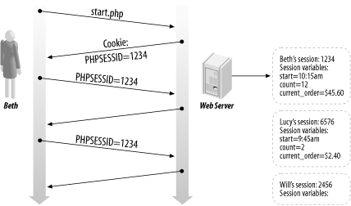
Storing the Session ID in cookies

Slide 21
Storing the Session ID in cookies
PHP uses cookies by default with sessions. If possible, a cookie will be set to store the session ID.
The other method is to pass the session id around by appending it to URL.
Adding SessionID to URL is turned off by default.
One can change this default (turn it on) by changing session.use_trans_sid in the php.ini
But not recommended as users can send these URLs to others and others may book mark those URLs (thus session hijacking may occur). These URLs may also live in the browser history, thus accessible to other users on the same computer.
PHP Scripts can also explicitly pass the SID (session id around) as follows.

Slide 22
Passing the session ID between pages
There are two methods to propagate a session id:
Cookies
URL parameter
The session module in PHP supports both methods.
Cookies are optimal, but because they are not always available, we also provide an alternative way.
The second method embeds the session id directly into URLs.
PHP is capable of transforming links transparently. session.enable_trans_sid and session.use_trans_sid – both of these can be enabled to send the session id automatically with the URLs. (No need to print the SID as indicated below)

Slide 23
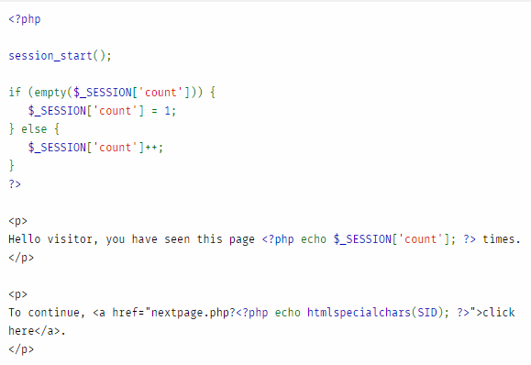
An example of passing SID explicitly through a page.

Slide 24
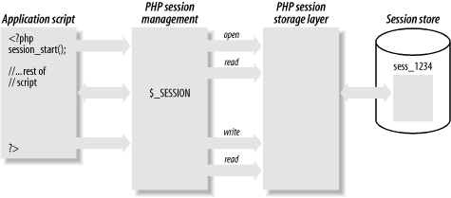
Steps in implementing sessions
1. Starting a session
2. Registering session variables
3. Using session variables
4. Deregistering variables
5. Destroying the session

Slide 25
1. Starting a session
session_start()
This function checks to see whether there is already a current session.
If not, it will essentially create one, providing access to the superglobal $_SESSION array.
If a session already exists, session_start() loads the registered session variables so that you can use them.
It is essential to call session_start( ) at the start of all PHP scripts that use sessions. Otherwise, anything stored in the session will NOT be visible to the script.

Slide 26
2. Registering Session Variables
$_SESSION[‘var_name’] = 10;
To create a session variable, you simply set an element in the $_SESSION array.
This session variable will be tracked until the session ends or until the variable is manually unset.
session.gc_maxlifetime setting (gc stands for garbage collection) in php.ini file can dictate a session to expire based on the time.
So, the session variables may also disappear along with the session due to automatic expiry setting (session.gc_maxlifetime)

Slide 27
3. Using Session Variables
$_SESSION[‘var_name’]
To access the session variables, you need to first start the session start_session( )
Then you will have access to the super global _SESSION
If any of these variables are object, then include “the class definition” prior to calling start_session(). PHP will then know how to reconstruct the objects from session variables.

Slide 28

3.1. Checking the presence of a variable
Be careful when you use isset( ), empty( ) methods.
Variables can be coming to PHP page through several methods POST
GET
SESSION
If you want to check whether SESSION contains a particular variable, you can do

Slide 29
4. Deregistering session variables
unset($_SESSION[‘myvar’]);
When you are finished with a session variable, you can unset it by unsetting the appropriate element in the super global $_SESSION.
You can unset all of the variables in the session as follows.
$_SESSION = array();
However, the above method literally kills the session as session is rendered useless now.

Slide 30
5. Destroying the session
When you are done with a session, you need to first unset all the variables.
Then call
session_destroy( );
It is not required to call session_unregister and session_unset (these are now obsolete; These are used prior to the introduction of $_SESSION.

Slide 31
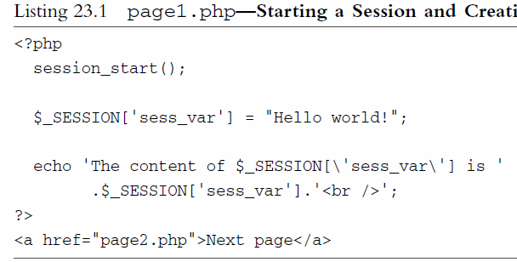
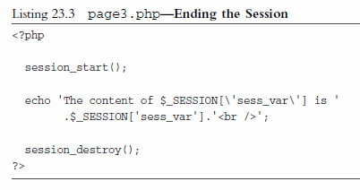
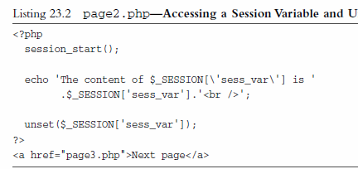
Let us try an example
Page1.php creates the session and a variable
Page2.php uses the same session and retrieves the variable
Page2.php also unsets the variable
Page3.php tries to retrieve the same variable (fails) and then destroys the session

Slide 32
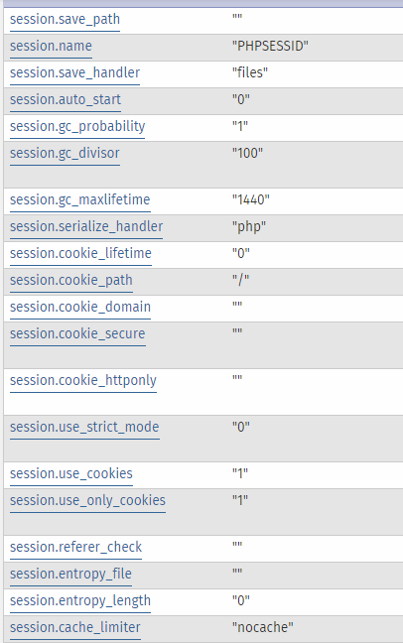
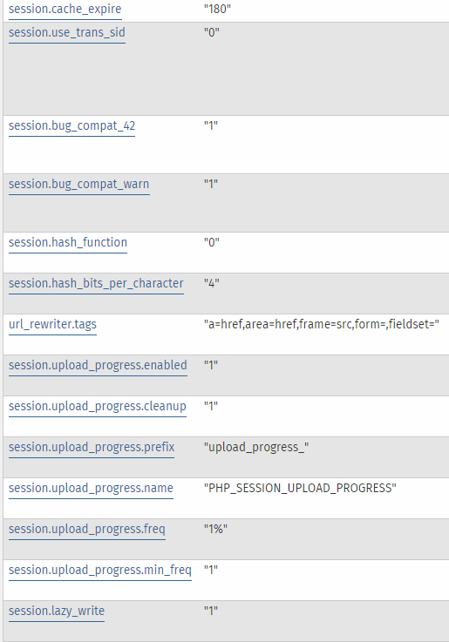
Session Configuration in php.ini
http://php.net/manual/en/session.configuration.php

Slide 33
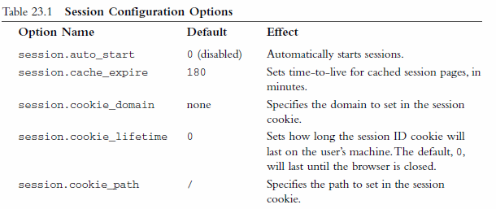
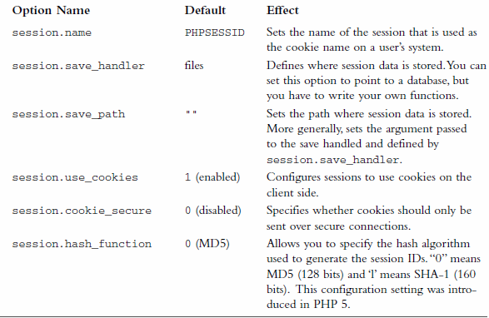
Session Configuration in php.ini
http://php.net/manual/en/session.configuration.php
There are many php.ini configuration options for session control.
Here are some key paramters.
You can play with these in your local xampp setup.
However, on hosted sites, you will not have much control on these

Slide 34
Summary
HTTP is a stateless protocol.
Maintaining the state between the web pages is needed to provide better usability, flow, personalization, persistance.
This is achieved through Session Control (Cookies, Sessions, Cookies + Sessions).
PHP Session module provides session control capabilities transparently through
session_start( ) method
$_SESSION(‘var_name’) super global
session_destroy( ) method

Slide 35
References
Cookies and Sessions
http://www.hackingwithphp.com/10/0/0/cookies-and-sessions
Introduction to Cookies
http://code.tutsplus.com/tutorials/an-introduction-to-cookies--net-12482
Cookie Specification (RFC2109)
http://www.ietf.org/rfc/rfc2109.txt
What do browsers do with expired cookies?
http://superuser.com/questions/356265/what-do-browsers-do-with-expired-cookies
Setting a cookie
https://www.youtube.com/watch?v=tOuym4a7XjY
Unsetting a cookie
https://www.youtube.com/watch?v=7Yx4RfxlqEk
PHP Session management
http://etutorials.org/Programming/PHP+MySQL.+Building+web+database+applications/Appendix+F.+Managing+Sessions+in+theDatabase+Tier/F.2+PHP+Session+Management/

